Slide 1
CDISC Biomedical Concepts Conceptual & Operational Standards Metadata Services (COSMoS)
Presented by Linda Lander, CDISC

Slide 2
Training Objectives
Gain understanding of CDISC Biomedical Concepts (BCs) and Dataset Specializations
Gain understanding of the associated data model
Gain familiarity with the BC curation templates, validation and governance processes
Understand how CDISC Library API Endpoints are used for retrieval of BCs and Dataset Specializations
Review of BC and Dataset Specialization examples
Gain high-level understanding of how SDTM Dataset Specializations can be used as building blocks for Define-XML
Consider how CDISC Dataset Specializations might be used to inform data flow

Slide 3
CDISC Biomedical Concepts and SDTM Dataset Specializations
3 Key pieces
Conceptual Layer – standards agnostic BC’s
Provides semantics - aligned with NCI terminology
Supports study design, Schedule of Activities (SOA)
Implementation Layer - Dataset Specializations aligned with standards
Dataset specializations as an extended dataset structure
Value level data supports programmers
Pre-configured building blocks for Define-XML
Tailored to BCs to link with unambiguous semantics & definitions
Extend foundational standards
Add explicit relationships between variables
Additional operational metadata, e.g., data type, etc.
Notes:
Explicit Variable Relationships
Extend Foundational Standards
Objectives
Improve understanding of what the variables are and how they are used
Help users find the variables they need within the overwhelming set of available variables.
Biomedical Concepts
What variables are needed to specify the test
Information on how the variables relate to each other
Help build validation
Help build transformation layer between CDASH and SDTM.
Help with data collection – what pieces are needed
Support analysis – what variables needed to define parameters for analysis

Slide 4
Tangible Value for CDISC Community
Pragmatic Implementation of Biomedical Concepts
Purpose:
Reduce variability in standards implementations
Increase metadata-driven automation and efficiency
Reduce barriers to operational implementation
Provides an iterative approach to creating biomedical concepts with a focus on providing tangible value for the CDISC community

Slide 5
CDISC Biomedical Concepts
MVP Objectives (now achieved):
Establish a logical data model
Establish a curation process and principles
Establish a validation/QC process
Establish versioning strategy
Establish APIs for retrieval of informative BC metadata/content retrieval
Establish a light-weight governance process with testable conditions for acceptance
Establish a pipeline for loading new content

Slide 6
CDISC Biomedical Concepts
General Principles:
Simplified, pragmatic, use-case focused approach
Initial use cases: Support study design, building blocks for Define-XML
Decoupled conceptual and implementation layers
BCs and Dataset Specializations are non-normative standards (informational only)
Build faster with rapid return on investment, an Iterative approach

Slide 7
BC Data Model
SDTM Variable
VSORRES
(float)
BC Core
Body Height
SDTM Group
HEIGHT
SDTM Variable
VSORRESU
(coded)
E
Codelist
(VSRESU)
1..+
1..1
1..*
1..*
1..*
CT Terms
in
1..*
1..*
1..*
1..1
CT Terms
mm
CDASH Group
HEIGHT
CT Terms
cm
Attribute
Vital Sign Result
(decimal)
CDASH Variable
HEIGHT_VSORRESU
1..+
Attribute
Unit of Height
CDASH Variable
HEIGHT_VSORRES
(float)

Slide 8
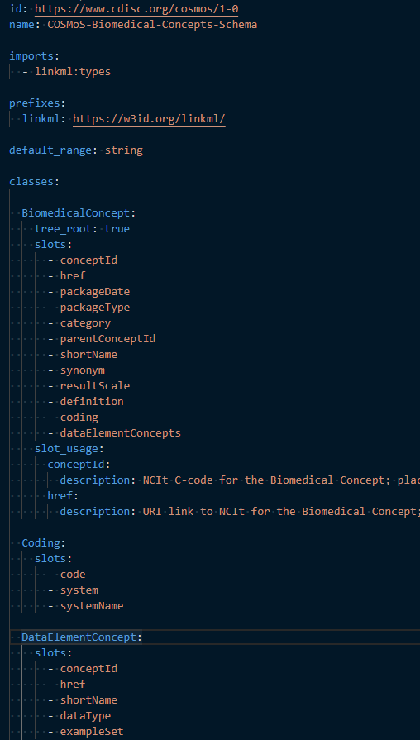
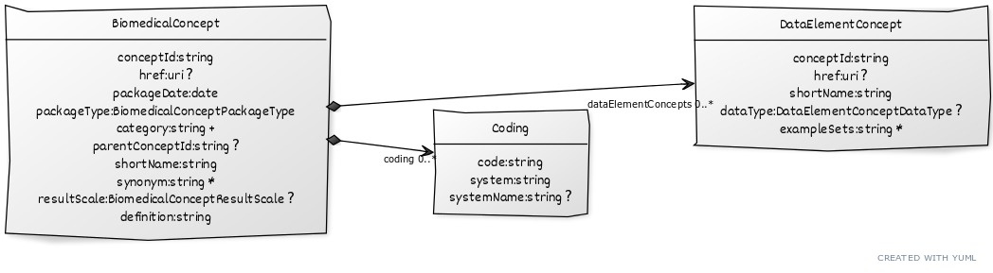
Biomedical Concept (BC) Data Model

Slide 9
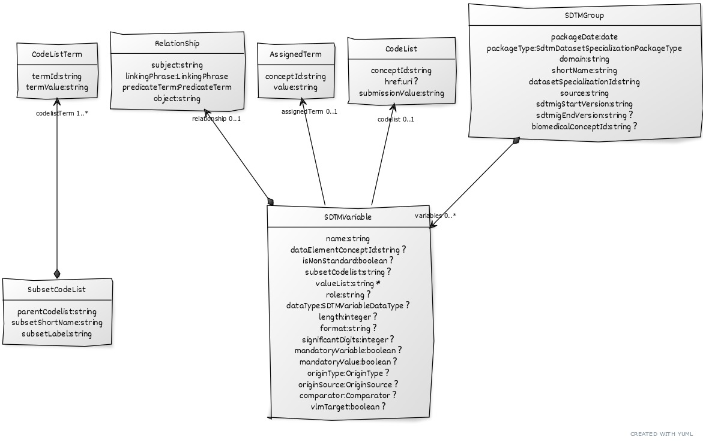
SDTMIG Dataset Specialization Data Model

Slide 10
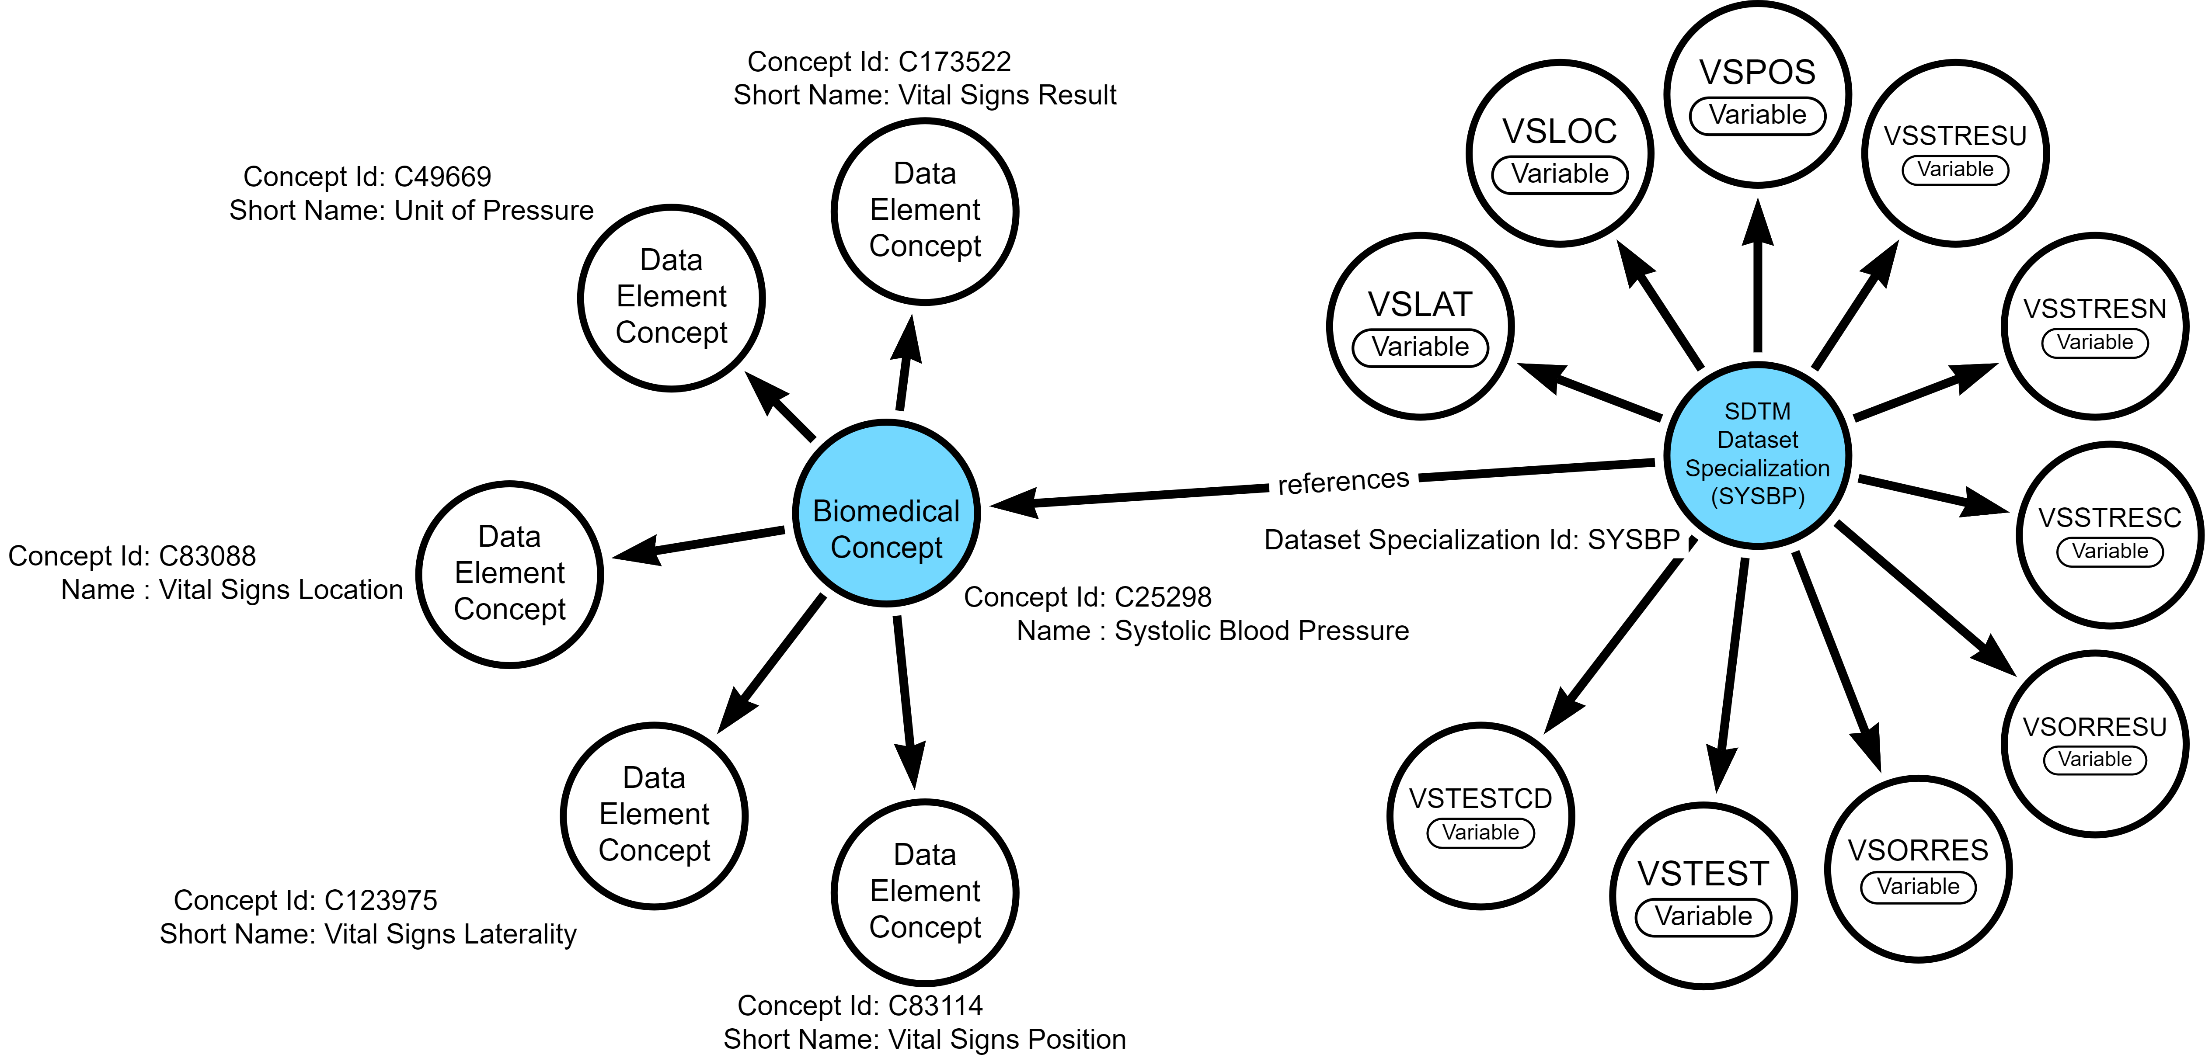
CDISC Biomedical Concepts and SDTM Dataset Specializations

Slide 11
CDISC Biomedical Concepts
Conceptual BC Curation Principles:
Standards agnostic – rooted in NCI-EVS definition
Encourage semantics while avoiding tedious debate
May include hierarchy (parent/child relationships) if deemed helpful
BC consists of one or more Data Element Concepts (DEC) as defined in the ISO 11179 standard
BC may be associated with other Coding Systems, e.g., LOINC

Slide 12
BC Curation Template
package_date | bc_categories | bc_id | ncit_code | parent_bc_id | short_name | synonyms | result_scales | definition | system | system_name | code | dec_id | ncit_dec_code | dec_label | data_type | example_set
2022-10-26 | Vital Signs; Body Measurements | C164634 | C164634 |  | Body Height | Height | Quantitative | The vertical measurement or distance from the base to the top of a subject or participant. | http://loinc.org/ | LOINC | 8302-2
2022-10-26 | Vital Signs; Body Measurements | C164634 | C164634 |  | Body Height |  |  |  |  |  |  | C173522 | C173522 | Vital Signs Result | decimal
2022-10-26 | Vital Signs; Body Measurements | C164634 | C164634 |  | Body Height |  |  |  |  |  |  | C168688 | C168688 | Unit of Height | string | Centimeter; Inch; Millimeter; Meter
2022-10-26 | Vital Signs; Body Measurements | C81328 | C81328 |  | Body Weight | Weight | Quantitative | The weight of a subject. | http://loinc.org/ | LOINC | 29463-7
2022-10-26 | Vital Signs; Body Measurements | C81328 | C81328 |  | Body Weight |  |  |  |  |  |  | C173522 | C173522 | Vital Signs Result | decimal
2022-10-26 | Vital Signs; Body Measurements | C81328 | C81328 |  | Body Weight |  |  |  |  |  |  | C48208 | C48208 | Unit of Weight | string | Kilogram; Gram; Pound

Slide 13
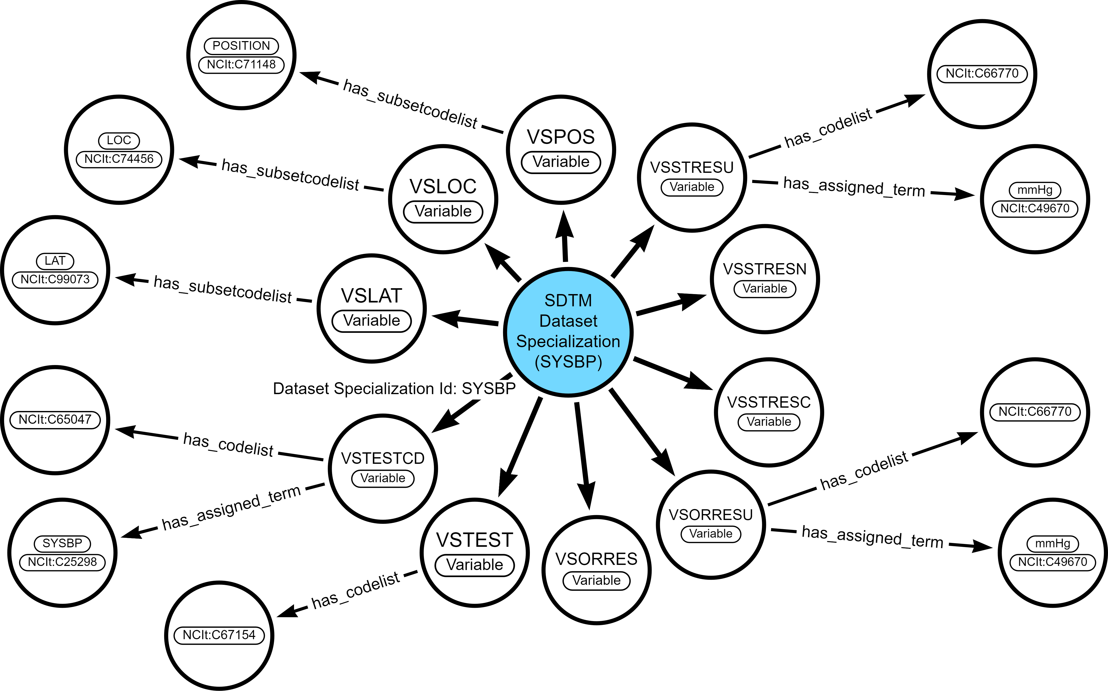
SDTM Dataset Specializations

Slide 14
CDISC Dataset Specializations
Curation Principles:
A Dataset Specialization is an operational implementation, e.g., SDTM, CDASH, etc., which may be associated with a conceptual BC
Dataset Specializations include relationships to NCIt terminology (codelists, value lists and terms)
Granularity of dataset specializations should be a group that is aggregable in a regulatory submission
Focused SDTM Value Level Metadata which provides building blocks for Define-XML
Looking ahead:
Focus on supporting CDASH aligned eCRF generation
Data flow across specializations (end-to-end)

Slide 15
SDTM Curation Template (a subset of model attributes shown)
package_date | bc_id | dec_id | sdtmig_start_version | sdtmig_end_version | domain | vlm_source | vlm_group_id | short_name | sdtm_variable | codelist | codelist_submision_value | value_list | assigned_term | assigned_value
2022-10-26 | C164634 |  | 3-2 |  | VS | VS.VSTESTCD | HEIGHT | Height | VSTESTCD | C66741 | VSTESTCD |  | C25347 | HEIGHT
2022-10-26 | C164634 |  | 3-2 |  | VS | VS.VSTESTCD | HEIGHT | Height | VSTEST | C67153 | VSTEST |  | C25347 | Height
2022-10-26 | C164634 | C173522 | 3-2 |  | VS | VS.VSTESTCD | HEIGHT | Height | VSORRES
2022-10-26 | C164634 | C168688 | 3-2 |  | VS | VS.VSTESTCD | HEIGHT | Height | VSORRESU | C66770 | VSRESU | in; cm; m
2022-10-26 | C164634 | C173522 | 3-2 |  | VS | VS.VSTESTCD | HEIGHT | Height | VSSTRESC
2022-10-26 | C164634 | C173522 | 3-2 |  | VS | VS.VSTESTCD | HEIGHT | Height | VSSTRESN
2022-10-26 | C164634 | C168688 | 3-2 |  | VS | VS.VSTESTCD | HEIGHT | Height | VSSTRESU | C66770 | VSRESU
2022-10-26 | C81328 |  | 3-2 |  | VS | VS.VSTESTCD | WEIGHT | Weight | VSTESTCD | C66741 | VSTESTCD |  | C25208 | WEIGHT
2022-10-26 | C81328 |  | 3-2 |  | VS | VS.VSTESTCD | WEIGHT | Weight | VSTEST | C67153 | VSTEST |  | C25208 | Weight
2022-10-26 | C81328 | C173522 | 3-2 |  | VS | VS.VSTESTCD | WEIGHT | Weight | VSORRES
2022-10-26 | C81328 | C48208 | 3-2 |  | VS | VS.VSTESTCD | WEIGHT | Weight | VSORRESU | C66770 | VSRESU | kg; LB; g
2022-10-26 | C81328 | C173522 | 3-2 |  | VS | VS.VSTESTCD | WEIGHT | Weight | VSSTRESC
2022-10-26 | C81328 | C173522 | 3-2 |  | VS | VS.VSTESTCD | WEIGHT | Weight | VSSTRESN
2022-10-26 | C81328 | C48208 | 3-2 |  | VS | VS.VSTESTCD | WEIGHT | Weight | VSSTRESU | C66770 | VSRESU
Demo: SDTM spreadsheet template

Slide 16




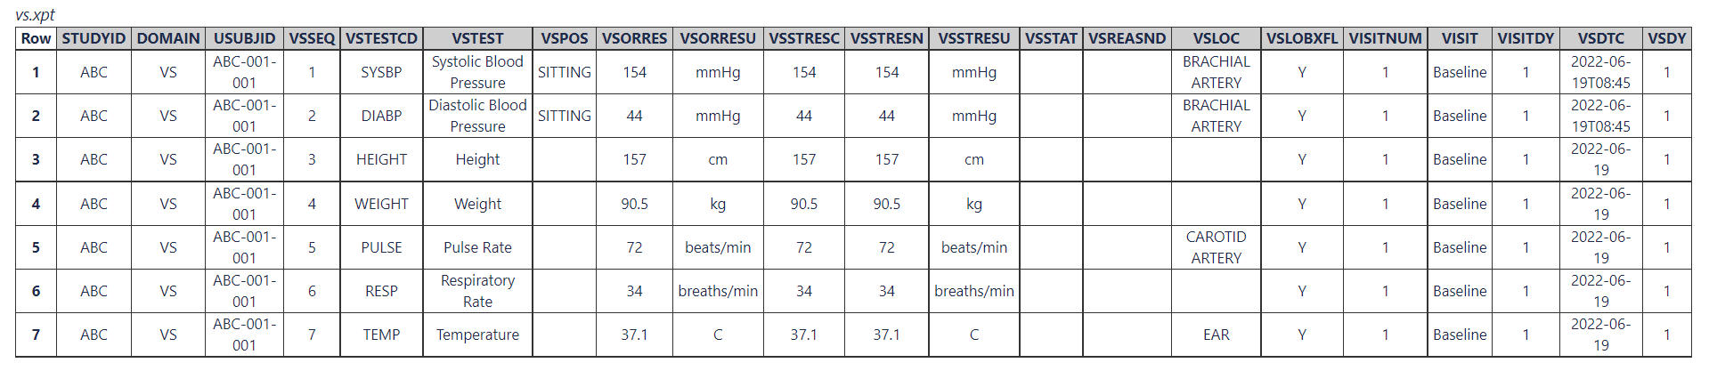
Focus on your data. Let the standards come to YOU
Your data
“shopping list”
CDISC Library
Retrieve your BCs and specializations as
machine-readable files
JSON
You’re most of the way there towards implementing CDISC for your data!

Slide 17
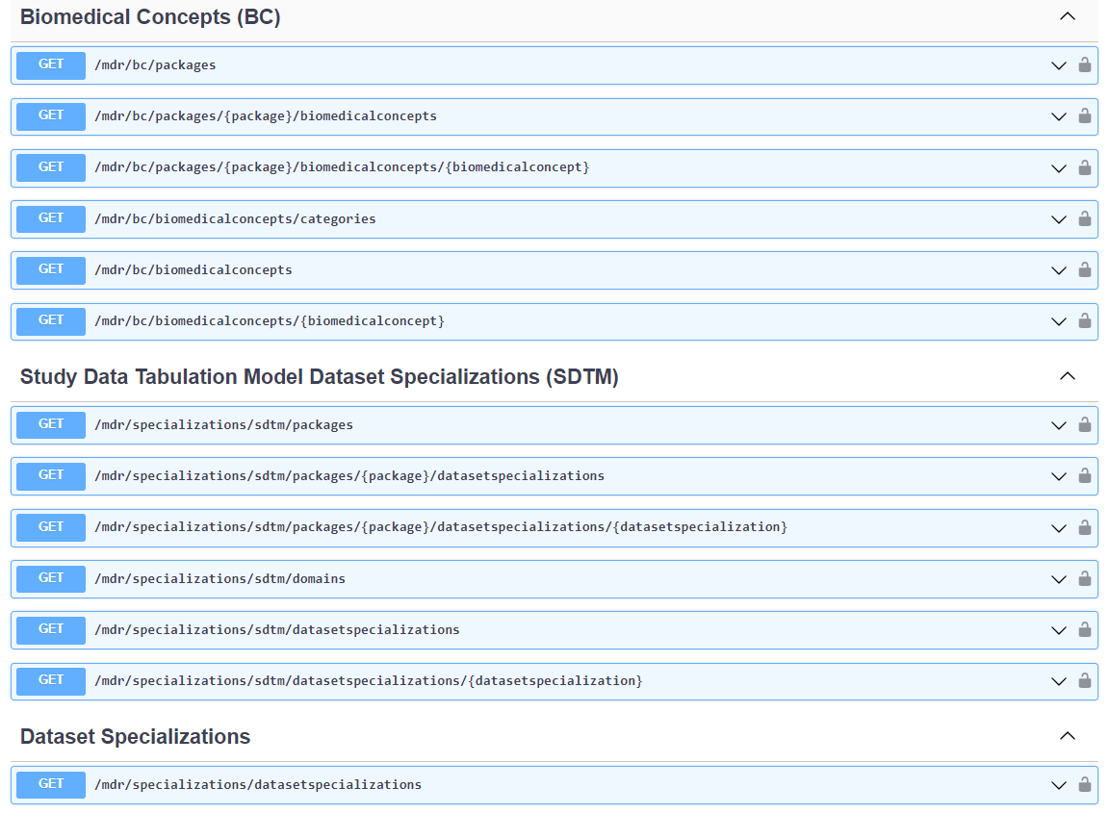

Slide 18
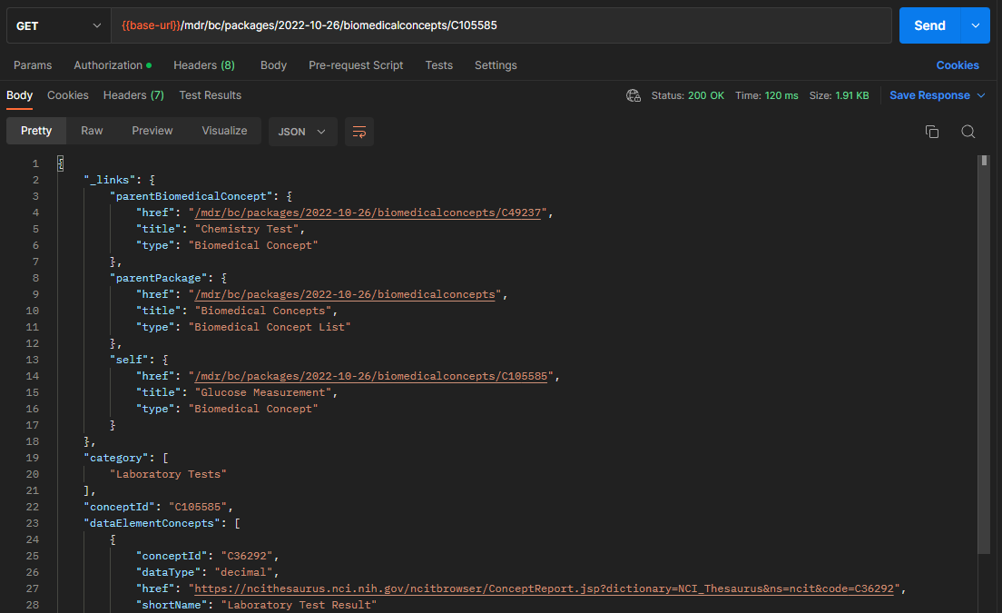
API Endpoints in CDISC Library

Slide 19
Use Case: Building Blocks for SDTM Define-XML
The simplified implementation approach is easy to understand and allows for quick return on investment.
SDTM Dataset Specializations can be represented as Value Level Metadata definitions in Define-XML v2.1. These definitions contain detailed metadata, including Controlled Terminology subsets.
The SDTM Dataset Specializations can be considered pre-configured building blocks, from which end-users can select and configure to build Value Level Metadata, which is an important part of the metadata for their Define-XML.
This provides immediate benefits to SDTM programmers and opens the door to efficient programming and automation

Slide 20
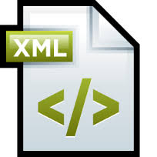
CDISC SDTM Dataset Specialization Metadata
Define-XML Metadata
Table Metadata
Column Metadata
Value Level Metadata
Codelist Metadata
Study Metadata
Standards Metadata
CDISC Library Terminology Metadata
Define-XML v2.1 + VLM + Terminology

Slide 21
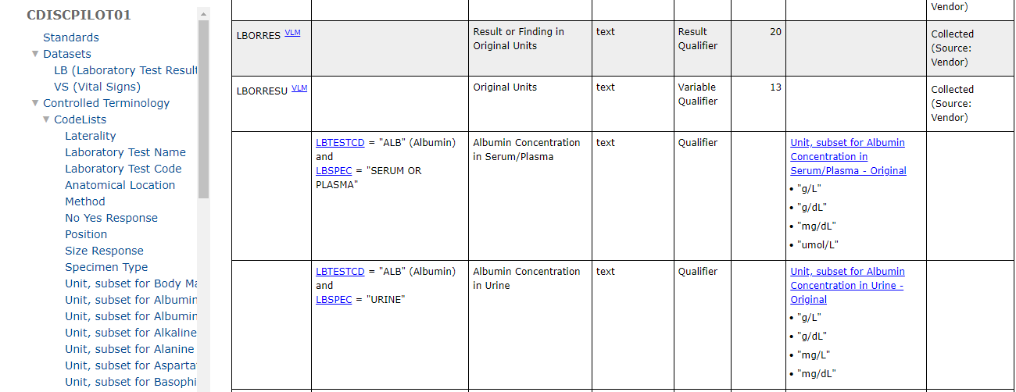
Result: Define-XML v2.1 document with complete SDTM Dataset Specialization: - Value Level Metadata and - Controlled Terminology metadata for the LB and VS domains

Slide 22
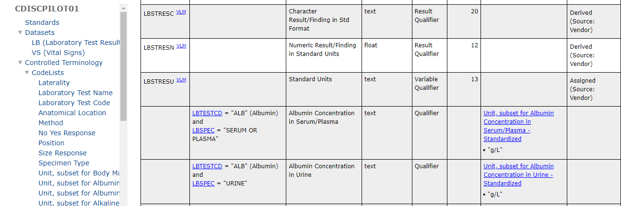
Result: Define-XML v2.1 document with complete SDTM Dataset Specialization: - Value Level Metadata and - Controlled Terminology metadata for the LB and VS domains

Slide 23
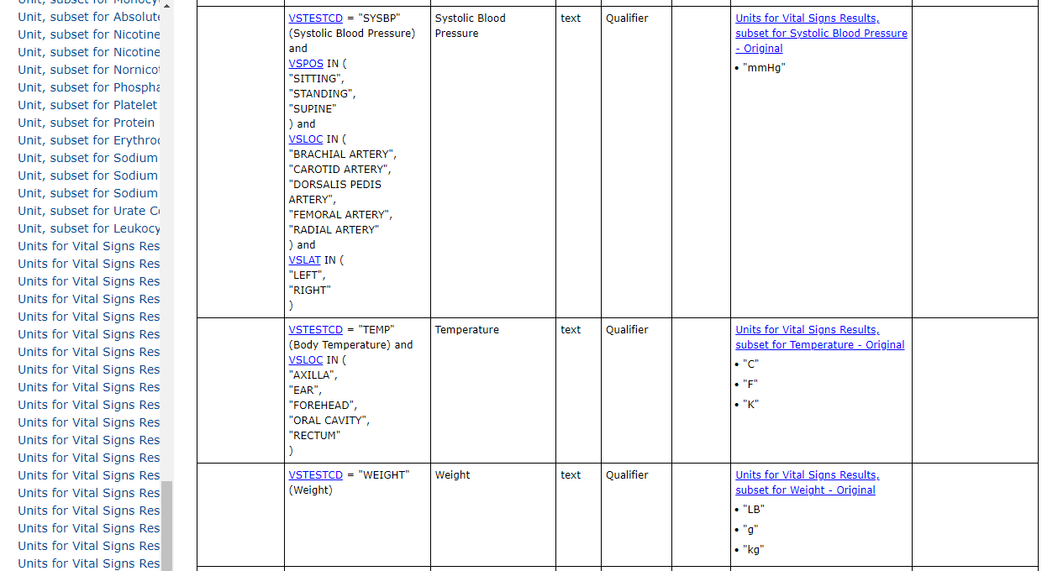
Result: Define-XML v2.1 document with complete SDTM Dataset Specialization: - Value Level Metadata and - Controlled Terminology metadata for the LB and VS domains

Slide 24
BC Validation/QC Plan
Validation for Provisional Release
CDISC BC Curators and SMEs perform initial review of content
Edit checks run over spreadsheet content, e.g., dups removed, valid BC ids, etc.
Convert to YAML – conformance rules run against YAML schema
Clean YAML files are loaded to CDISC Library
JSON output from APIs compared to YAML for quality and completeness
BCs available for provisional use - available via CDISC Library APIs
Formal Release
Includes a public review cycle
Published as CDISC standards – available via CDISC Library

Slide 25
CDISC Library Release Plan
Provisional Content:
BCs and dataset specializations will be released provisionally as new content becomes available
New content can be released without undergoing formal public review, making it available sooner for users
Formal BC Release Schedule:
BCs and dataset specializations formally released after brief public review cycles
Review cycles will be similar to CT review cycles
Enable a users to provide feedback using existing JIRA mechanism.

Slide 26
CDASH Curation Template (draft) (a subset of model attributes shown)
bc_id | domain | cdash_group | short_name | scenario | cdash_variable | nsv_flag | question_text | prompt | data_type | length | significant_digits | cdashig_core | sdtm_target_variable | sdtm_target_group
C164634 | VS | HEIGHT | Height | Horizontal | HEIGHT_VSORRES |  | What was the result of the height measurement? | Height | float | 8 | 3 | HR | VSORRES | HEIGHT
C164634 | VS | HEIGHT | Height | Horizontal | HEIGHT_VSORRESU |  | What was the unit of the height measurement? | Height Unit | text | 20 |  | R/C | VSORRESU | HEIGHT
C81328 | VS | WEIGHT | Weight | Horizontal | WEIGHT_VSORRES |  | What was the result of the weight measurement? | Weight | float | 8 | 3 | HR | VSORRES | WEIGHT
C81328 | VS | WEIGHT | Weight | Horizontal | WEIGHT_VSORRESU |  | What was the unit of the weight measurement? | Weight Unit | text | 20 |  | R/C | VSORRESU | WEIGHT
Demo: CDASH spreadsheet template

Slide 27
CDISC Dataset Specializations Informing Data Flow and Mapping
A Step Towards Automation of End-To-End Standards
CDISC to collaborate with OAK-SDTM Automation Project to evaluate how CDISC Dataset Specializations can store mapping metadata
Potentially conduct a POC that demonstrates how CDISC Dataset Specializations can include OAK mapping metadata to facilitate end-to-end automation

Slide 28
Questions

